Slide 1
Vocalism and the Limits of Articulation
Jonathan Chaparro
Dr. Carlos Arrizabalaga
Dr. Donaldo Urioste
Dr. Rafaél Goméz

Slide 2
Abstract
Vocalism and the Limits of Articulation
Linguistics is the science of language. Phonetics is a discipline within linguistics. Phonetics describes the physical action of articulation and the physical characteristics of spoken sound. Vocalism is a phonetic term that categorizes the vowel system of a given language. This presentation demonstrates vocalism and its limits of articulation within the spanish language in comparison to english. To explain this contrast, I constructed an analysis of the articulatory limits of the vowel /a/ in spanish, and those of the corresponding sounds in english.

Slide 3
Overview
Articulation
Place of articulation
Manner of articulation
Vowels vs. Consonants
Vowel classification
Conclusion

Slide 4
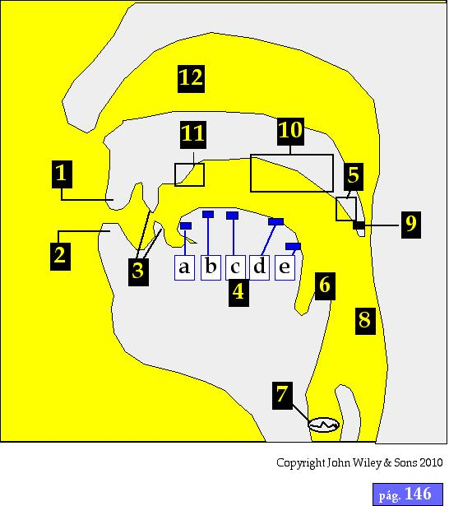
Articulatory Phonetics

Slide 5
Articulation
In relation to phonetics, articulation is the combined movement of the speech organs.

Slide 6
Articulation
Active place of articulation
Upper lip
Tongue
Larynx (vocal chords)
Soft palate
Passive place of articulation
Teeth
Alveolar ridge
Hard palate

Slide 7
Active place of articulation
1. Upper lip
4. Tongue
7. Larynx (vocal chords)
5. Soft palate
Passive place of articulation
3. Teeth
11. Alveolar ridge
10. Hard palate

Slide 8
Place of articulation
Point of articulation is when active, and passive articulation cause obstruction of air passing through the vocal tract to make a phone.
/Phone/ is a spoken sound
-Jonathan Chaparro

Slide 9
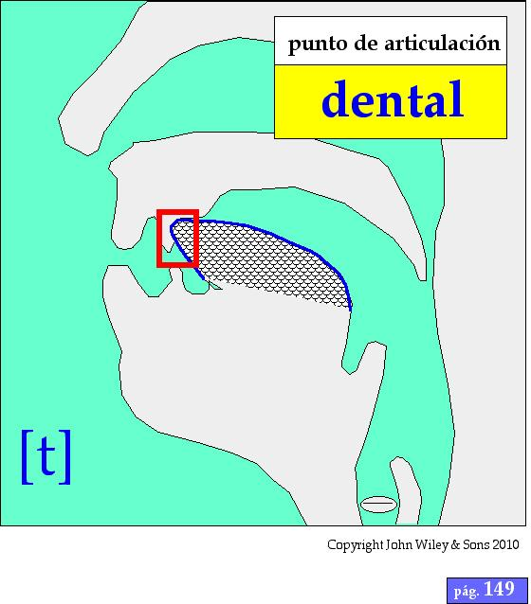

Slide 10
Manner of articulation
nasal | /nasal/
stop | /gato/
friction | /frente/
affricate | /lechuga/

Slide 11
Point of Articulation + Manner of Articulation
=
INTERNATIONAL PHONETIC ALPHABET

Slide 12
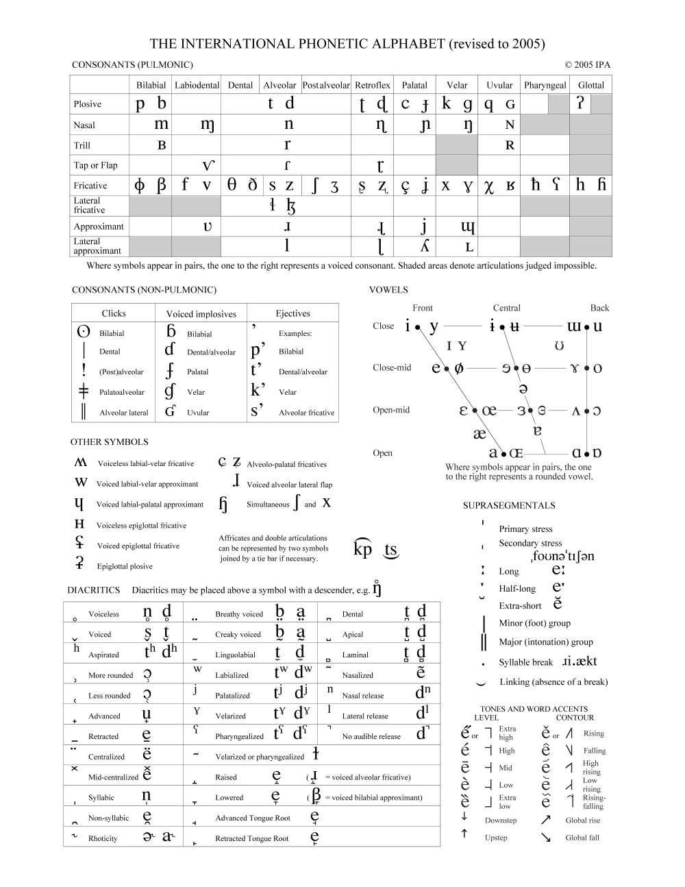

Slide 13
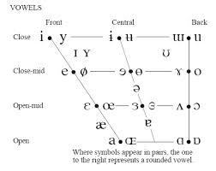
Phonetic Transcription of the Vowels

Slide 14
Vowels vs. Consonants
Sonorous vs. Deaf

Slide 15
Vowel
In relation to phonetics, a vowel, is a spoken sound that experiences little to no obstruction of air within the vocal tract.
Orthographic representation in Spanish and English:
i, e, a, o, u

Slide 16
Vowel classification
Vertical Plane (height of the tongue)
- high, medium, low
2. Horizontal Plane (lateral heightening of the tongue)
- anterior, central, posterior
3. Roundedness (lips)
- stretched, neutral, rounded
4. Nasalization

Slide 17
Height of the Tongue

Slide 18
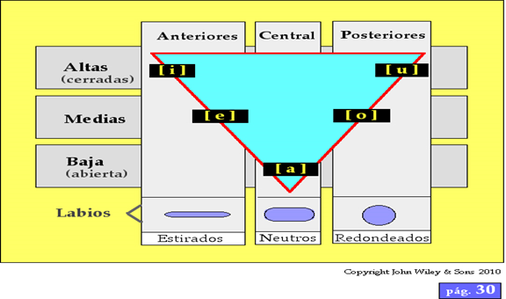
Vowel Classification

Slide 19
Why did I choose to analyze /a/?
/i/, /e/, /a/, /o/, /u/

Slide 20
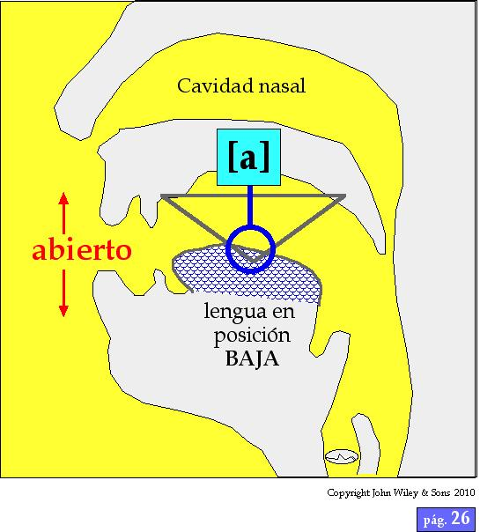

Slide 21
Articulatory limits of /a/ in Spanish
Vertical Plane:
low
Horizontal Plane:
central
Lips:
neutral

Slide 22
Articulatory limits of the short /a/ in English
e.g. /cat/
Vertical Plane:
low
Horizontal Plane:
central
Lips:
mild-straightening

Slide 23
Articulatory limits of the long /a/ in English
e.g. /crate/
Vertical Plane:
low-medium
Horizontal Plane:
central-anterior
Lips:
straightened

Slide 24
Conclusion
Each vowel sound has its limits of articulation.
The next step of research will be to analyze the concordance, and interrelationship of the vowels; both in the Spanish and English language.

Slide 25
Questions?

